Slide 1
Chap 10. Deformation of Solids
By Lim WH 2012

Slide 2
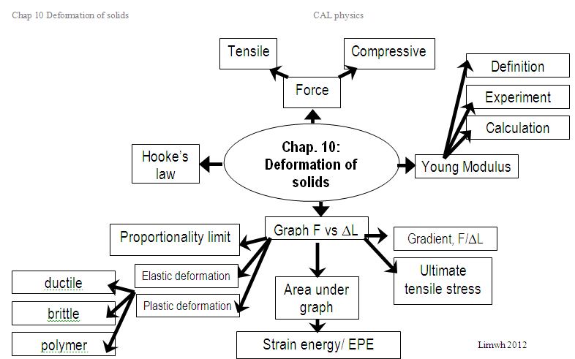

Slide 3
Learning Outcomes
(a) appreciate that deformation is caused by a force and that, in one dimension, the deformation can be tensile or compressive
(b) describe the behaviour of springs in terms of load, extension, elastic limit, Hooke’s law and the spring constant (i.e. force per unit extension)
(c) define and use the terms stress, strain and the Young modulus and ultimate tensile stress
(e) distinguish between elastic and plastic deformation of a material

Slide 4
Tensile force vs Compressive force
Forces cause deformation of solids
Tensile force causes an increase in length when it applies on a material.
Compressive force causes an decrease in length when it applies on a material.

Slide 5
Example 1
P
To which direction are the forces acting on Point P?
To which direction are the forces acting on pole A and B?
A : tensile force
B : compressive force

Slide 6
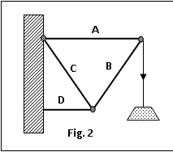
Example 2
A : tensile force
B : compressive force
C : tensile force
D : compressive force

Slide 7
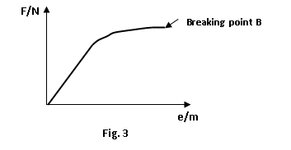
Hooke’s Law
State Hooke’s law.
Force exerted to stretch a spring is directly proportional to the extension [1] provided proportionality limit is not exceeded [1]
From the origin to P, obeys Hooke’s law & elastic
E
P
From P to E, does not obey Hooke’s law but elastic

Slide 8
Elastic & Plastic deformations
Explain what is happened on the shape of material when it is stretched
  before the elastic limit
  the material returns to the original shape when the applied force is removed.
  beyond the elastic limit (i.e. plastic deformation)
  the material retains some of the permanent extension when the applied force is removed.
Applied force
Applied force
Applied force
Applied force

Slide 9
Elastic & Plastic deformations
F/N
E
F/N
E
loading
loading
unloading
unloading
ΔL/m
ΔL/m
Permanent extension

Slide 10

Stress & strain
Define the following terms and state its units:
  Stress – force per unit cross sectional area, units Pa or Nm⁻²
  Strain – extension per unit original length
diameter, d
diameter, d
Stress = F/A
where A = $\frac{π}{4}d^{2}$ for a cylindrical wire
Strain = ΔL/L
where ΔL is the extension
Length, L
Length, L
extension, Δ L
Applied force, F

Slide 11


ultimate tensile stress & Young Modulus
ultimate tensile stress – maximum force that a material can withstand before breaking
Define Young modulus
  Stress per unit strain
  units Pa or Nm⁻²
Max Stress = F_{max}/A
where A = $\frac{π}{4}d^{2}$ for a cylindrical wire
F_{max}
Young Modulus, E
E= $\frac{\frac{F}{A}}{\frac{∆L}{L}}$
E =$\frac{F L}{∆L A}$

Slide 12

Young Modulus
Young modulus, E is a measure of material’s resistance to change its length within its proportionality limit.
It is a measure of stiffness/rigidity.
Materials | E/GPa
Steel | 210
Brass | 90-110
Aluminum | 70
Concrete | 40
Lead | 18
Perspex | 3
Polystyrene | 2.7-4.2
Rubber | 0.01
glass | 70-80
Example 1:
A steel wire 3.6 m long & 0.6 mm in diameter carries a mass of 7.0 kg. By how much does the wire stretch in excess of its original length? Given E_{steel} =1.9x10¹¹ Nm⁻²
$∆L$ =$\frac{F L}{E A}$
F= 7x 9.81
A= $\frac{π}{4}{\left(0.0006\right)}^{2}$
L = 3.6

Slide 13
Problem solving – Young Modulus
An elastic string of cross-sectional area 3 mm² and length 2.5 m stretches by 2.5 cm when a force of 4 N is applied to it. Determine the Young modulus for the material of the string. [1.33x10⁸Pa]
A rod of cross-sectional area 8.0 x 10⁻⁶m² is made of a material for which the Young modulus is 2.1 x 10¹¹ Pa and which breaking strain is 1.0 x 10⁻³. Assuming Hooke's law is obeyed until the rod fractures, calculate the tensile force needed to cause fracture. [1680N]

Slide 14
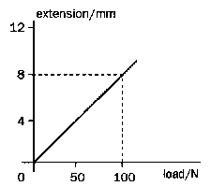
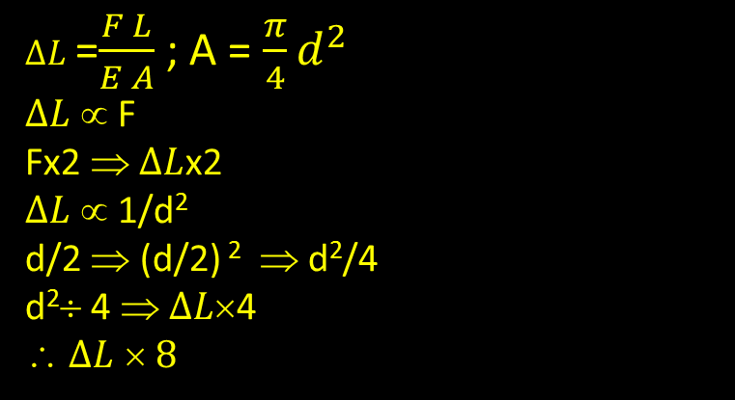
Problem solving – Young Modulus
The graph shows the variation of extension with applied load for a wire of length 4 m and radius 0.25 mm. Calculate the Young modulus for the wire material. [2.55 x 10¹¹ Pa]
A cylindrical wire of length L and diameter D is stretched by a load of W is hung on it. What happens to the extension when the load is doubled and the diameter is halved.
$∆L$ =$\frac{F L}{E A}$ ; A = $\frac{π}{4}d^{2}$
$∆L$ ∝ F
Fx2 ⇒ $∆L$x2
$∆L$ ∝ 1/d²
d/2 ⇒ (d/2) ² ⇒ d²/4
d²÷ 4 ⇒ $∆L\text{×}\text{4}$
∴ $∆L$ $\text{}\text{ 8}$

Slide 15
Learning Outcomes
(d) describe an experiment to determine the Young modulus of a metal in the form of a wire
(f) deduce the strain energy (Elastic PE) in a deformed material from the area under the force-extension graph
(g) demonstrate knowledge of the force-extension graphs for typical ductile, brittle and polymeric materials.

Slide 16
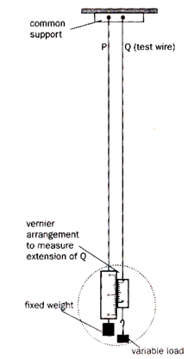

Experiment to measure Young Modulus
Two wires P and Q of the same diameter, material and length are hung from a common support, as shown in the diagram.
Wire Q is the wire under test and wire P is the comparison wire. The use of a comparison wire as a reference standard avoids errors due to
    Fluctuation in temperature
    Sagging of the support
Any small increment in length of wire P is accurately measured by the vernier arrangement between P and Q.
The original length of Q (L) is measured using a measuring tape and the cross- sectional area (A) is obtained by measuring the diameter of Q using a micrometer screw gauge at several points and in at least two directions across the wire.
These precautions are necessary to minimise errors due to unevenness in the cross-section of the wire. The mean diameter is then calculated and used to calculate the cross-sectional area A = $\frac{π}{4}d^{2}$
The test wire is then incrementally loaded and the corresponding extensions are measured and noted. The results are used to plot a graph of extension ΔL against load (F).

Slide 17

Analysis
Determine the gradient of the graph, ΔL/F
Substitute the gradient, L and A into the formula
E =$\frac{F L}{∆L A}$=$\frac{L}{gradient × A}$
ΔL/m
F/N

Slide 18
Force vs extension and Stress vs strain
F/A
F/N
Stress/Pa
ΔL/m
strain
ΔL/L
Gradient = F/ ΔL
= force constant k
Gradient = stress/strain
= Young Modulus
Area under the graph = ½ F ΔL = EPE or strain energy
Or ½ kx²
Area under the graph = ½ stress x strain
= EPE or strain energy per unit volume
Obeys Hooke’s law

Slide 19
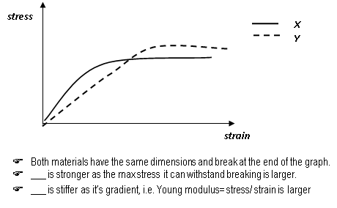

Slide 20
examples
A support cable on a bridge has an area of cross-section of 0.0085 m² and a length of 35 m. it is made of high tensile steel which Young modulus is 2.8 x 10¹¹Pa. the tension in the cable is 720 kN. Calculate:
  the extension of the cable [10.6mm]
  the strain energy stored in the cable [3.82kJ]
  What is the assumption made in the calculation of part (ii)?
Estimate strain energy stored
when a wire is stretched to 0.3 m.
A. 1.2 J
B. 1.5 J
C. 1.8 J
D. 3.0 J
ΔL/m
0.3
0
10
F/N

Slide 21
Strain energy in Elastic & Plastic deformations
Confined area = work done to produce permanent extension after it is fully unloaded.
F/N
E
F/N
E
loading
loading
unloading
unloading
ΔL/m
ΔL/m
EPE is stored during loading
Permanent extension
EPE is restored during unloading

Slide 22
Stress-strain graphs for ductile, brittle & polymeric materials
 | Ductile | Brittle | Polymeric
graph of stress vs. strain | obeys Hooke’s law Elastic & Plastic deformations | obeys Hooke’s law It breaks after Elastic limit. Only elastic deformation. | Does not obey Hooke’s law.
Examples | Metallic wires | Ceramics, glass, porcelain | PVC, polyethylene, rubber….
force
force
force
extension
extension
extension

Slide 23

Springs
When a number of springs, with spring constant k1, k2 and so forth, are connected in series, the spring constant k of the combination is given by
$\frac{1}{k}=\frac{1}{k_{1}}+\frac{1}{k_{2}}$ +…
When a number of springs, with spring constant k1, k2 and so forth, are connected in parallel, the spring constant k of the combination is given by
$k=k_{1}+k_{2}$+…

Slide 24
Examples
Five identical springs, each has a spring constant k and extends by x when a load of W is hung, are connected as shown below:
Express (i) the spring constant of the combination and (ii) the strain energy stored, in terms of k and x, where appropriate.
W

